Slide 1
3D Audio Interface for Rich Mobile Web Experiences
International ICST Conference on Mobile Computing, Applications, and Services
Monday, October 25, 2010, Santa Clara, CA
Victor K.Y. Wu and Roy H. Campbell
University of Illinois at Urbana-Champaign
Department of Electrical and Computer Engineering
Department of Computer Science

Slide 2
Acknowledgements
Dr. Virginia W.T. Chu, Rehabilitation Institute of Chicago
Professor Alex Kirlik, Human Perception and Performance Group, UIUC
Professor Yih-Chun Hu, ECE, UIUC
Mirko Montanari, Systems Research Group, UIUC

Slide 3
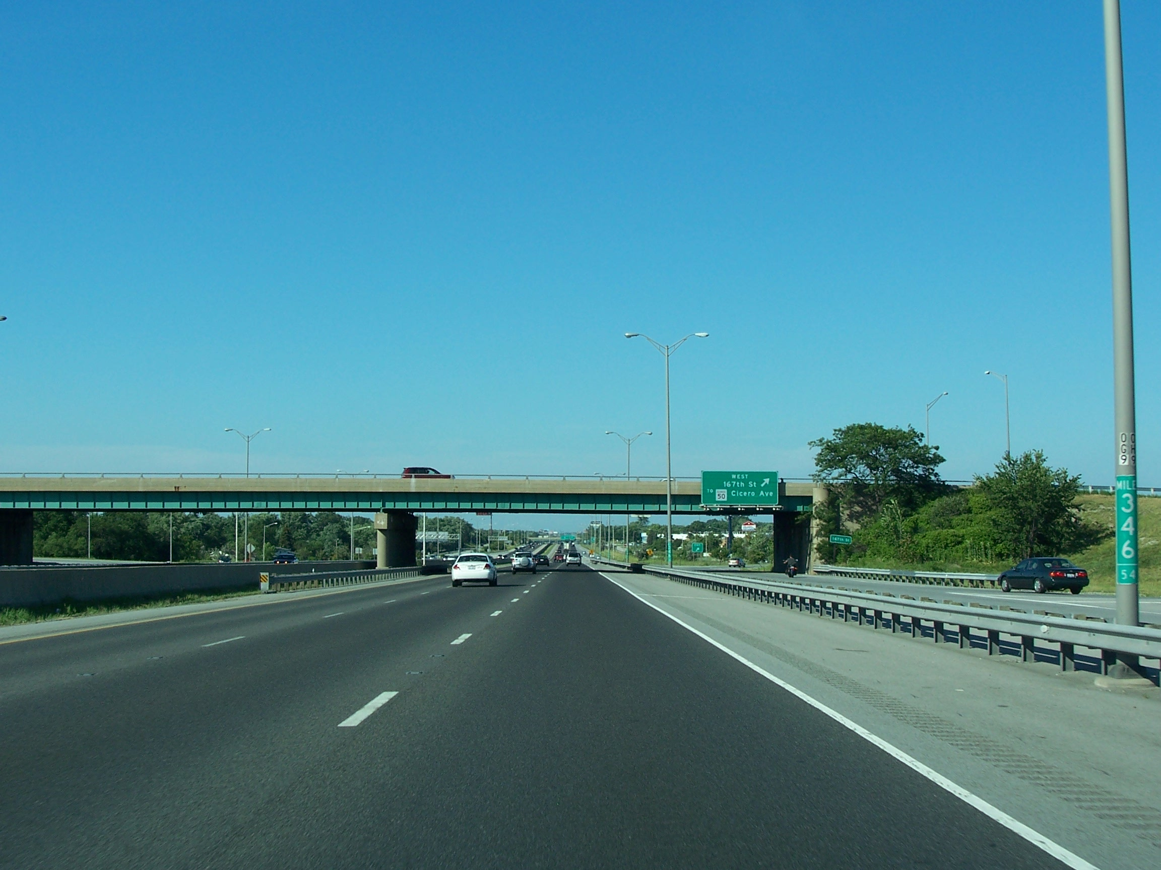
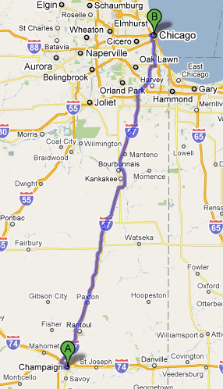

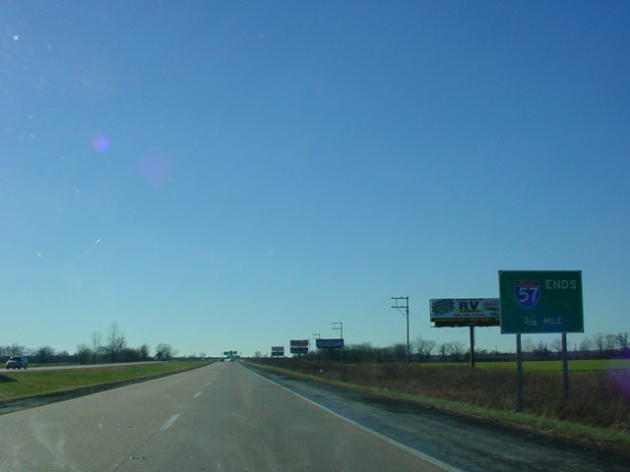
Images from:
http://maps.google.com/
http://upload.wikimedia.org/wikipedia/en/7/72/Interstate_57_-_Country_Club_Hills,_Illinois.jpg
http://www.okroads.com/122003/i57moends34mi.JPG
http://commons.wikimedia.org/wiki/File:I-57_(IL).svg

Slide 4
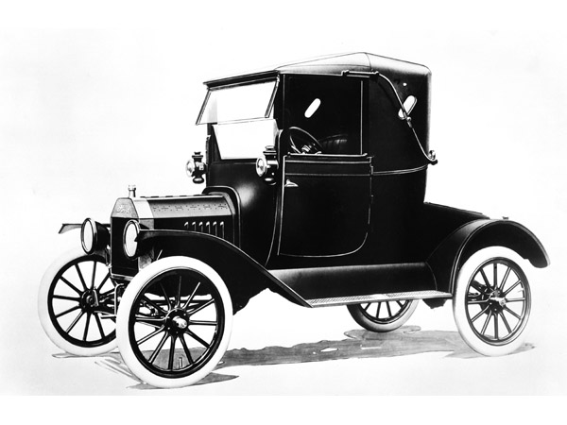

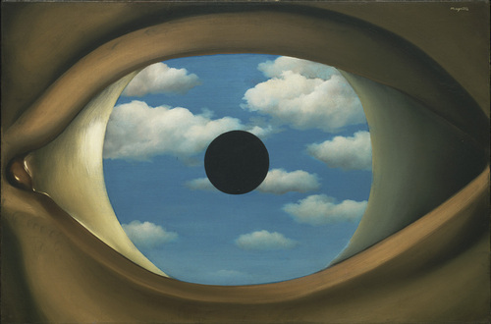
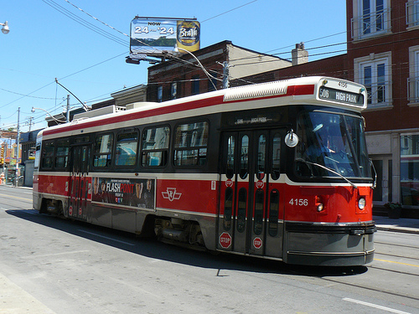
Images from:
http://cdn.cbsi.com.au/story_media/339292667/ford-model-t_14.jpg
http://images.clipartof.com/small/5151-Boy-Riding-A-Tricycle-Bike-Clipart.jpg
http://farm4.static.flickr.com/3201/2801885108_c3e7a706d5.jpg
http://www.moma.org/collection_images/resized/017/w500h420/CRI_151017.jpg

Slide 5
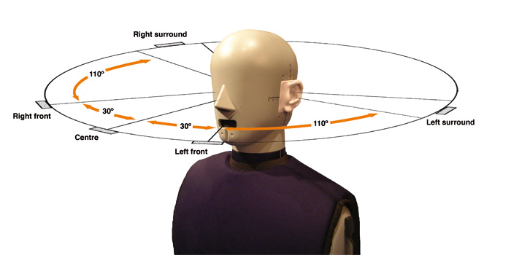
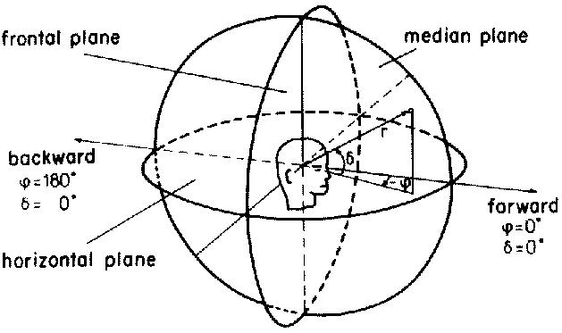
Images from:
http://www.soundonsound.com/sos/jan08/images/MP3Surround_01.jpg
http://web.media.mit.edu/~raffik/zero-g/aup/Figure3.jpg

Slide 6
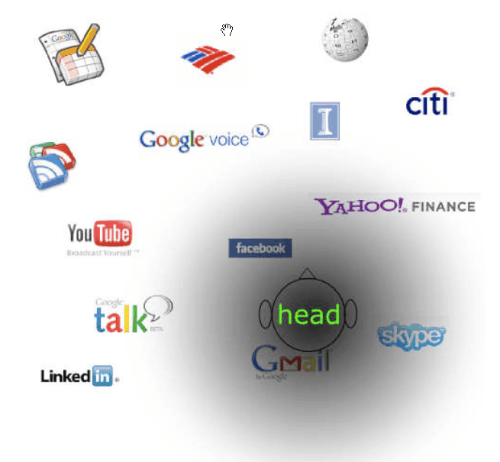

Slide 7
Agenda
Motivations and Related Work
Applications
System Designs
System Architecture
System Prototype
Future Work

Slide 8
Motivations and Related Work
Truly pervasive web → rich mobile web experience
Enabling technologies
Enabling human factors
Digital systems for the visually impaired

Slide 9
Applications
Productivity
Social networking
Location-Based

Slide 10
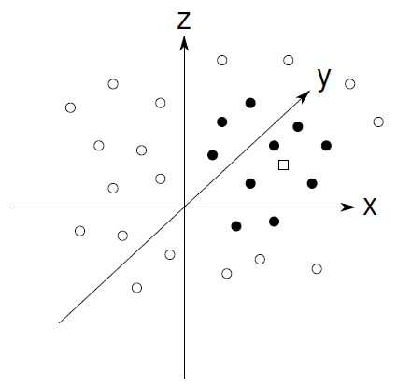

Slide 11
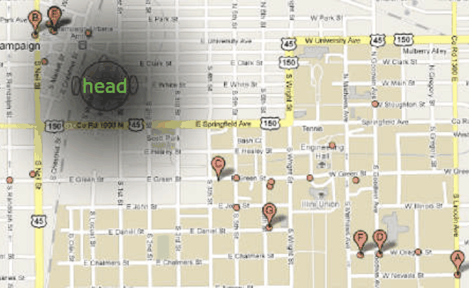
Images from:
http://maps.google.com/

Slide 12
System Designs
Movable 3D audio spaces
Sound stream prioritization
Sound encoding
Non-optimized websites versus audio-optimized web services

Slide 13


Slide 14
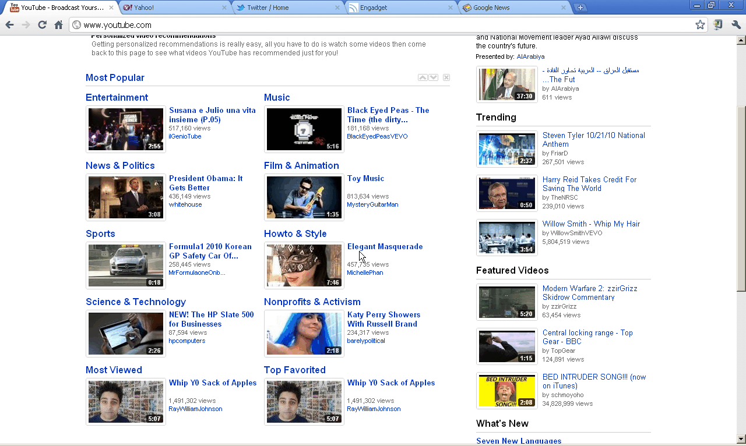
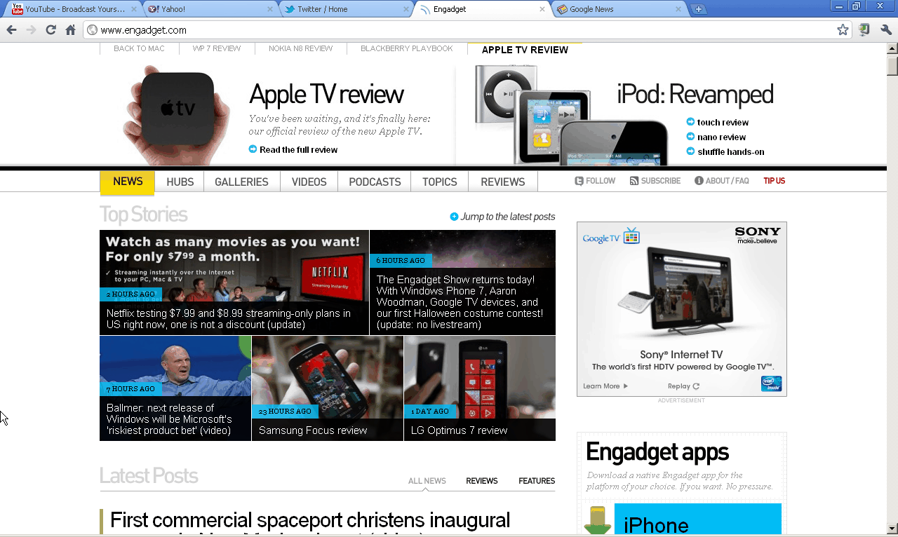
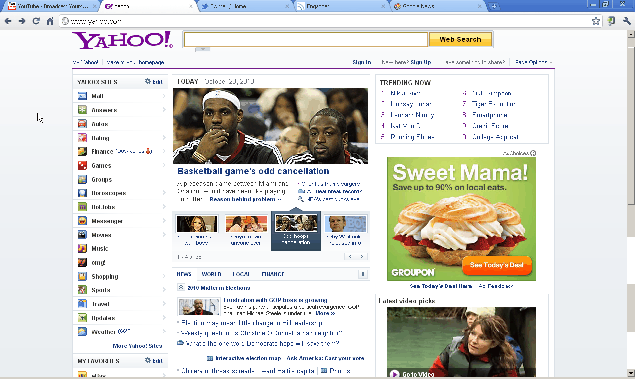

Slide 16
System Designs
Existing and emerging web protocols: Rendering web pages, peer-to-peer communications, streaming media, microblogging, mobile, etc.
Web browsers for visually impaired exist, some even use 3D audio
Want 3D audio web protocols and standards, i.e. local control → remote control

Slide 17
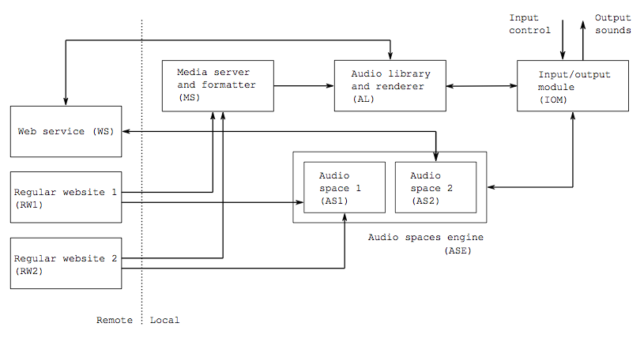
System Architecture

Slide 18


System Prototype
Apple iOS
Audio RSS reader
Images from:
http://images.apple.com/iphone/ios4/images/ios4_icon_20100624.png
http://itunes.apple.com/us/app/3d-audio-rss-music-player/id363753578?mt=8

Slide 19
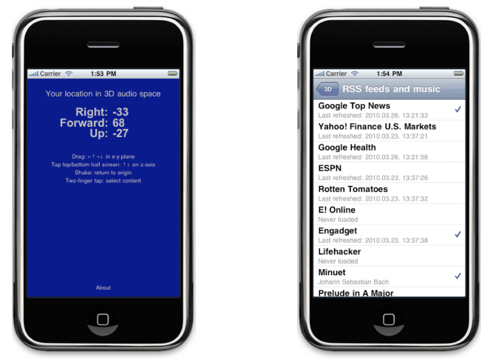
System Prototype

Slide 20
System Prototype
Use TTS in the MS
One audio space in ASE
Gestures from IOM to ASE
AL renders sound using OpenAL

Slide 21
Future Work
Further interface designs
Sound aspects: pitch (frequency), quality (harmonics), reverberation (echoes)
Spatial and temporal together
Quantitative analysis → psychoacoustics

Slide 22
Questions

